Slide 1
Math and Movement, putting Action Based Learning w/RTI process
Emily Anderson
Physical Education Teacher
India Hook/Cherry Park Elem.

Slide 2
Action Based Learning
www.youthfit.com
Most of what I know about ABL comes from company in Charleston whose mission is to reach the child LEAST likely to succeed, LAST in line and LOST in the system.
Focus on ‘filling’ the developmental gaps
Other information has been from articles and educational resources
ABL can take on many different forms; key is putting learning and purposeful movement together
10 Developmental Foundations Learning…
Disclaimer…Shout out (Guyton/Roof), no expert

Slide 3
1) Balance 2) Cardio 3) Strength 4) Rhythm/sequencing 5) Vestibular 6) Gross & 7) Fine Motor Skills 8) Cross Lateralization 9) Visual Tracking 10) Proprioception
Notes:
Balance: Balancing helps the brain to place words on a page, to read from left to right and to write patterns in sequence
Cardio: Physical Activity and exercise change the learning state to optimize retention and retrieval of memory
Strength: Upper body and hand strength allows the students to write for longer periods

Slide 4
Why move in class?
30% extra blood flow, oxygen and glucose to the brain improves learning abilities!
After exercise, people learn new vocabulary 20% faster…
Brain Benefits of Exercise:
Improves memory
Lengthen attention span
Boost decision making skills
Improves multi-tasking and planning
Increases production of neurochemicals that promote brain cell repair
Promotes growth of new nerve and blood cells
Notes:
*now we know that not all of our students come to us with all of the basic fundamentals of movement…so what does this mean? We just skip over them just hoping that they will eventually ‘catch’ up? No..we make purposeful movements to help connect the brain and allow those developmental gaps to fill up…THEN allowing knowledge to be attained…so why else do we move in class?

Slide 5
How to include ABL in your classroom?
Students’ favorites: Yoga balls, duck walkers and wobble seats, reader’s theater, movement tables...($ from grants/Donor’s choose)
Standing and counting, but hopping on one foot when you say an odd number, and jumping on 2 feet when you say an even number.
Having students move in and out of a circle to show fractions, decimals, and percentages.
Jumping a number line (i.e. use only multiples)
Balance while counting backwards or saying number sentences (etc.)
Any thoughts?

Slide 6
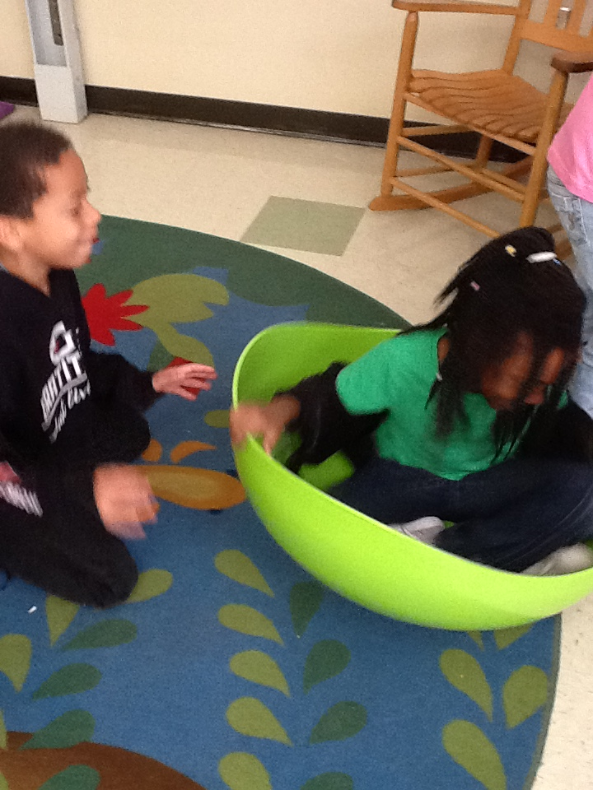
Pirate’s way motor learning lab…est. ‘18
How teacher’s can use it?
How parents can use it?
Notes:
Explain what india hook has done the last two years (progress to action based learning lab for math RTI)
Teachers can take class down for activity break (used sign-up genius to set up times, or had sign-up sheet outside door)
Parent volunteers can monitor students who need to ‘refocus’ their attention and use the room either weekly or daily mental break

Slide 7
Math RTI…adding ABL
It’s about putting movement together with simple tasks (i.e. skip counting, number sentences, repetition)
Can be completed as a class or individuals
Go ahead and create your ABL folder with pictures and tasks for students to complete
Practice different movements together as a class (recommended everyday)
Don’t forget to LEAD by EXAMPLE ☺ you should move too when practicing
Also, remember exercise can always be modified!

Slide 8
Who should be responsible?
Teachers adding ABL to math RTI
Parents using lab for Math RTI
- Thinking back to the 10 Fundamentals of Learning, what are some basic movements that you could have students complete while working in math? Here are some parameters:
- Establish high expectations
- Model each movement station
- Use daily repetition
- Ensure student success prior to moving on
- Practice makes permanent
- Have consequences for moving out of control
- Being able to have your own Action Based Learning Lab allows parent volunteers to come and complete the stations and activities with the students.
- Ideally parent volunteers would be able to come everyday and for 20 minutes with students; Realisticly parents could work with specific students weekly for 20 minutes.

Slide 9
India Hook Example (there is no one and only way)…make it your own!
- Outlined a 20 minute schedule for once a week, roughly 7 students per time, 1st and 2nd grade
- Designed stations based on 10 fundamentals of learning and created challenges/focus for each station
- Created different assessments to help their learning and practice simple tasks (+/- up to 10 or 20)
- Used assessments to document RTI time and learn what to help focus on next time
Notes:
Most of the time tasks were working on skip counting while performing the exercise or completing the station

